Slide 1

PROGRAMMING FUNDAMENTALS

Slide 2
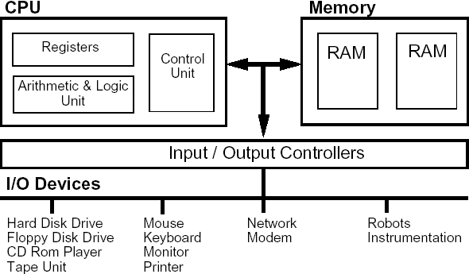
COMPUTER ARCHITECTURE
BASIC STRUCTURE
VON NEUMANN

Slide 3
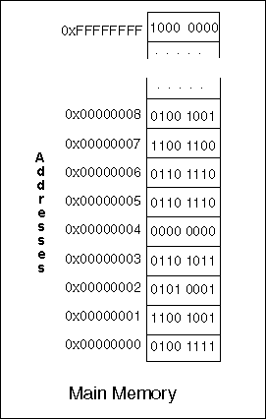
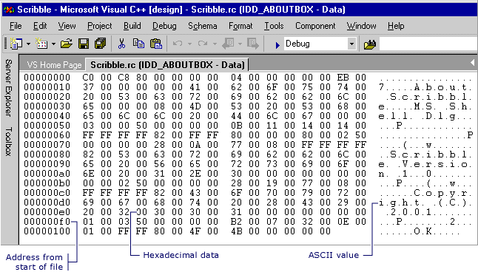
COMPUTER ARCHITECTURE
HOW DATA IS REPRESENTED ON A COMPUTER SYSTEM

Slide 4
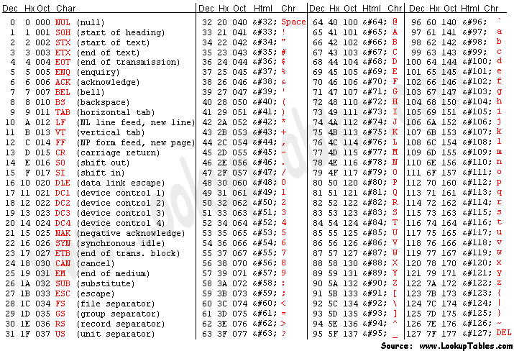
COMPUTER ARCHITECTURE
HOW DATA IS REPRESENTED ON A COMPUTER SYSTEM

Slide 5
COMPUTER ARCHITECTURE
HOW DATA IS REPRESENTED ON A COMPUTER SYSTEM
BINARY SYSTEM
UNSIGNED NUMBER
10111110
DECIMAL = 190, HEX = BE
2⁸
…
2¹
2⁰
SIGNED NUMBER
DECIMAL = -66
10111110
1 = negative
10111110
01000001 + 1
01000010

Slide 6
COMPUTER ARCHITECTURE
HOW DATA IS REPRESENTED ON A COMPUTER SYSTEM
Jl. Mega Kuningan Barat No.3,
RT.5
RW.2,
Kuningan,
Kuningan Tim.,
Kecamatan Setiabudi,
Kota Jakarta Selatan,
Daerah Khusus Ibukota Jakarta
CODEVA

